Slide 1
Design and Verification of I2C Protocol
Siva Sai Srinivas Rao Gadamsetti
Sai Venkat Dabbara
Pruthvi Malapati Manjunath
Sai Bhargav Reddy Gujjula
Bhavya Reddy Gandheti
Naga Sri Harsha Challagulla

Slide 2
Presentation Plan :
Introduction to I2C Protocol
Timing Diagram of I2C Protocol
Block Diagram of the Top Module of I2C Design
Finite State Machines Flowcharts – I2C & Mem. Contr.
SystemVerilog Constructs Used
Timing Diagram of I2C Module
Implementation of Classes to Verify
Use of Assertions
Challenges Faced and Way Forwards
Future Scope
References

Slide 3
Introduction to I2C Protocol
Inter-Integrated Circuit
synchronous, multi-master/multi-slave, serial communication bus
lower-speed peripheral IC’s – Microcontrollers
two bidirectional open-collector or open-drain lines (SDA&SCL)
Message protocols – START, MESSAGE, STOP

Slide 4
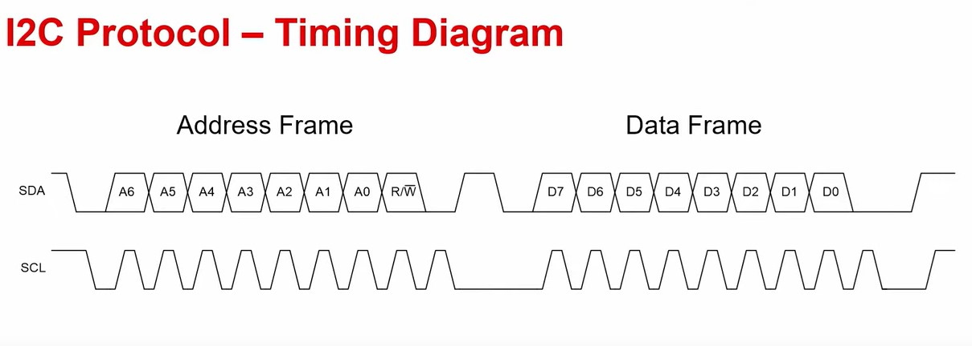
Timing Diagram of I2C Protocol
Taken from Texas Instruments

Slide 5
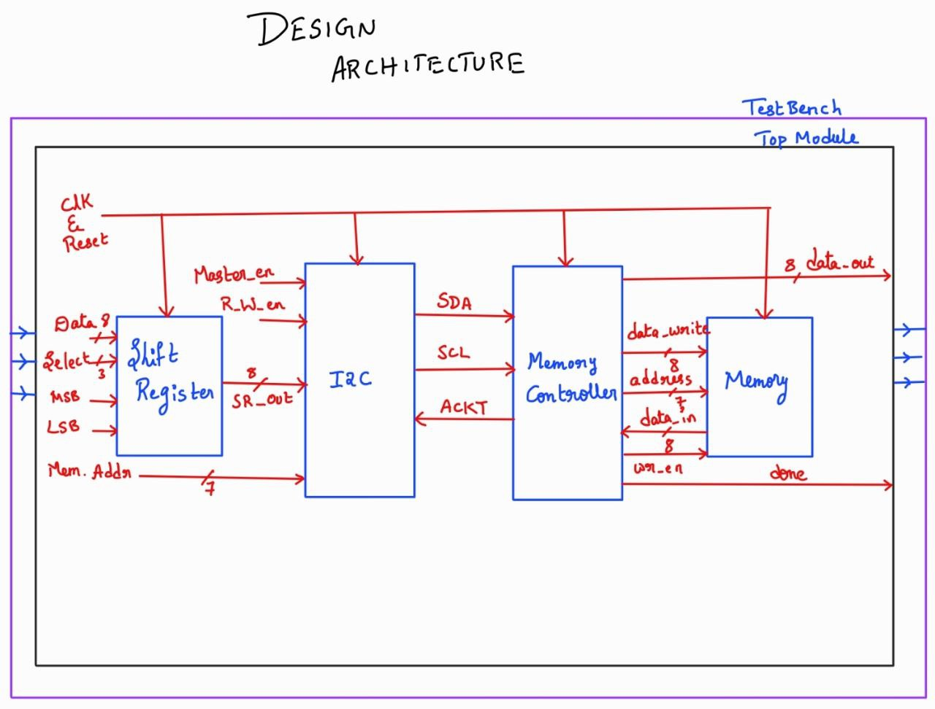
Block Diagram of the Top Module of I2C Design

Slide 6
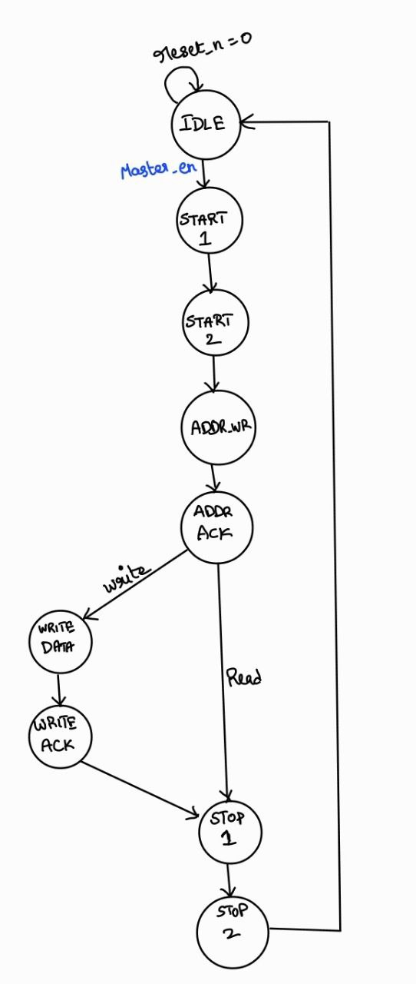
Finite State Machines Flowcharts – I2C & Mem. Contr.

Slide 7
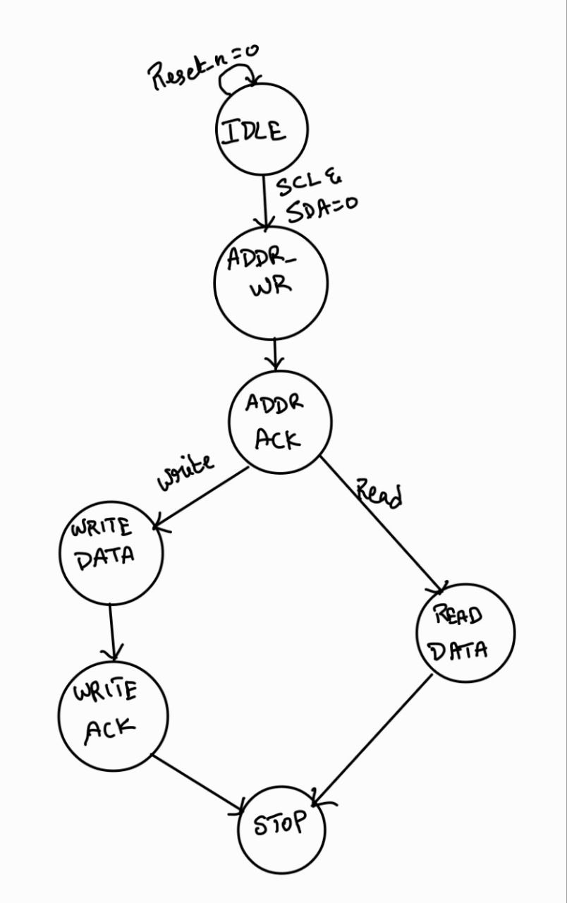
Finite State Machines Flowcharts – I2C & Mem. Contr.

Slide 8
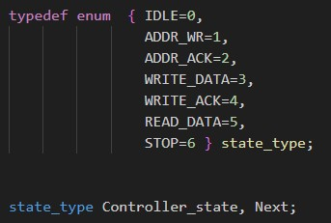
SystemVerilog Constructs Used
Typedef

Slide 9


SystemVerilog Constructs Used
Procedural Blocks

Slide 10
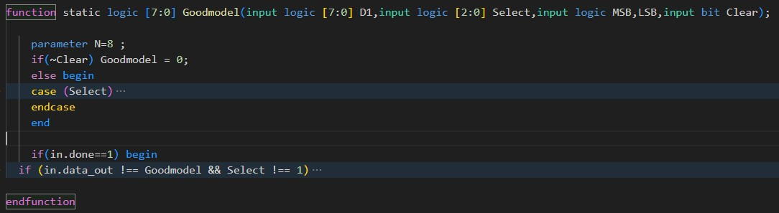
SystemVerilog Constructs Used
Functions

Slide 11
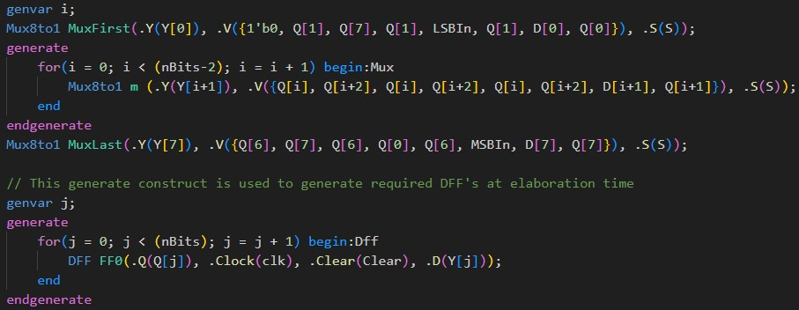
SystemVerilog Constructs Used
Generate Construct

Slide 12
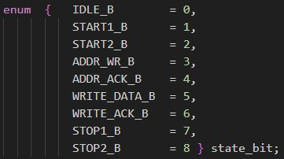
SystemVerilog Constructs Used
Reverse Case - FSM

Slide 13
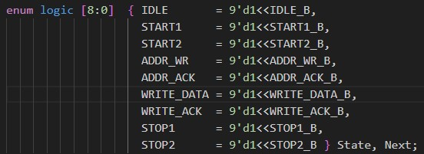
SystemVerilog Constructs Used
Reverse Case - FSM

Slide 14
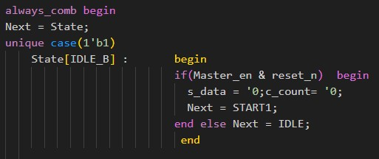
SystemVerilog Constructs Used
Reverse Case - FSM

Slide 15
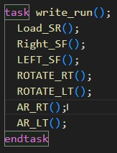
SystemVerilog Constructs Used
Tasks

Slide 16
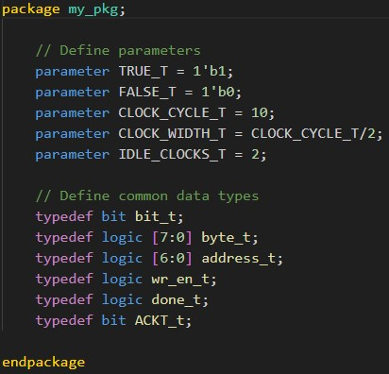
SystemVerilog Constructs Used
Packages

Slide 17
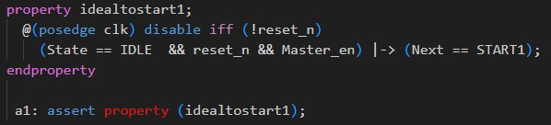
SystemVerilog Constructs Used
Assertion

Slide 18
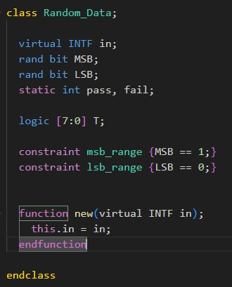
SystemVerilog Constructs Used
Class

Slide 19
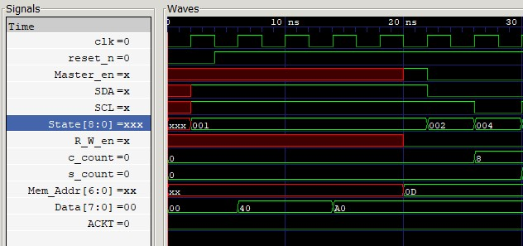
Timing Diagram of I2C Module

Slide 20
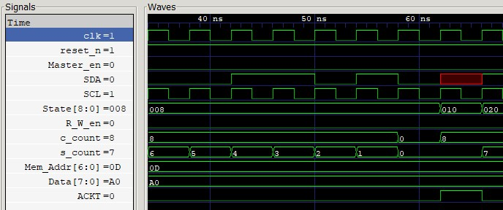
Timing Diagram of I2C Module

Slide 21
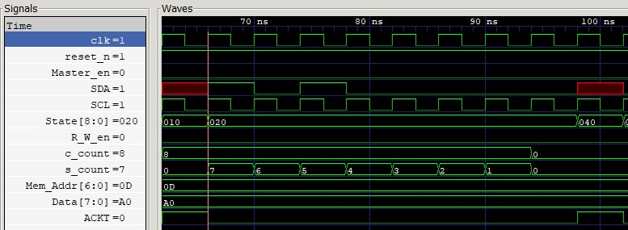
Timing Diagram of I2C Module

Slide 22
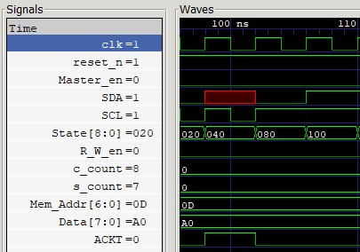
Timing Diagram of I2C Module

Slide 23
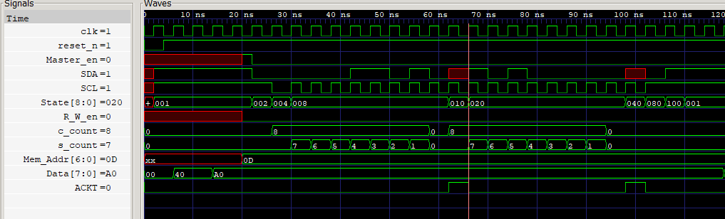
Write operation:

Slide 24
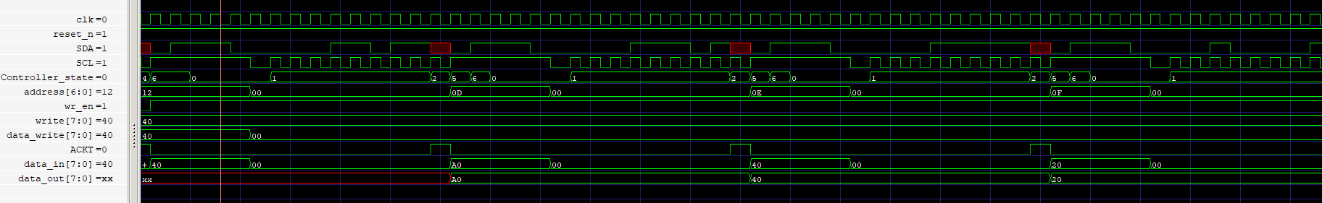
Read Operation:

Slide 25
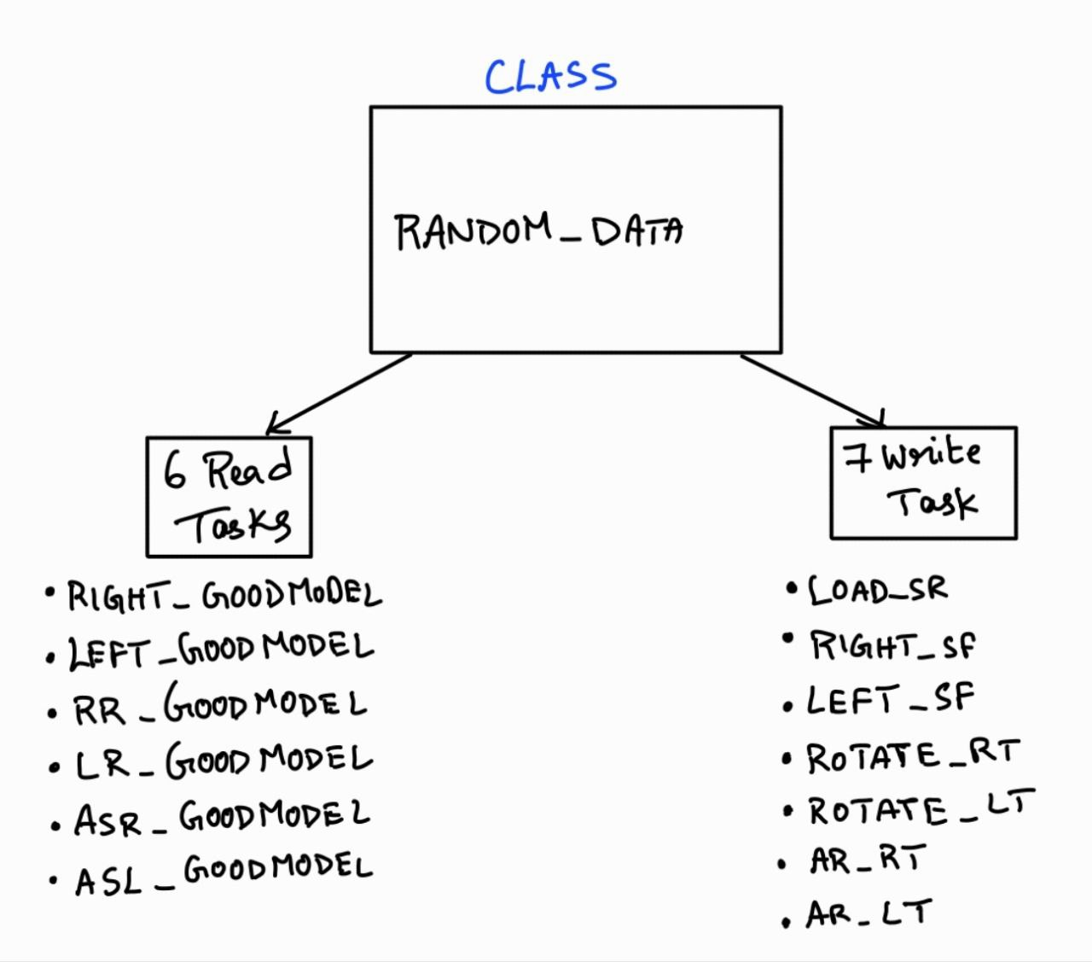
Implementation of Classes to Verify

Slide 26
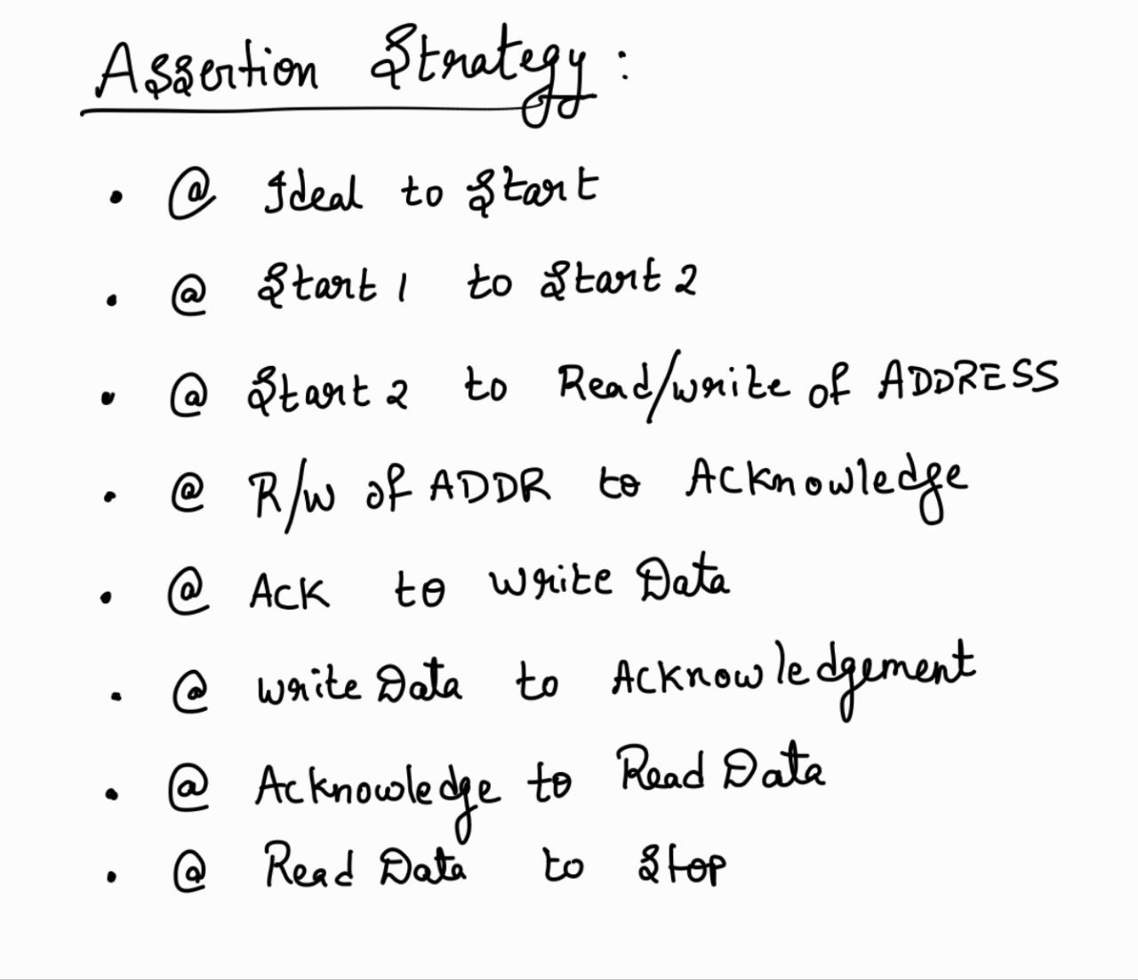
Use of Assertions

Slide 27
Challenges Faced and Way Forwards
Understanding the concepts of I2C vis-à-vis Memory Interface.
Synchronization of two FSM’s
Modelling Classes to Verify

Slide 28
Future Scope
Implementation of Lock-Step Synchronization Using Interfaces
More Randomizations to Testbench
More Coverage Analysis

Slide 29
References
https://www.youtube.com/watch?v=j9yx8LOslng&t=633s
https://en.wikipedia.org/wiki/I%C2%B2C

